Slide 2
The European Cluster Partnerships | Excellence
13 European Cluster Partnerships…
…made up of 69 cluster organisations…
… across 21 European countries !

Slide 3
Partners and Ecosystems
Representing > 840 members
of which >500 SMEs
and 130 among Universities / Research centers and other ecosystems actors.

Slide 4
"EXXTRA ClusterXchange scheme"
→ Pilot scheme to support short-term exchanges to better connect Europe’s industrial ecosystems
Profiles of participants:
Cluster organisations and business network organisations from COSME participating countries
SMEs from a COSME participating country that are cluster members
Scaling-up support organisations from COSME participating countries that are cluster members (research institutes, fab labs, [digital] innovation hubs, creative hubs, resource-efficiency service providers, incubators and accelerators).

Slide 5
ClusterXchange important details :
1. Number of exchanges: As VO you can only make one exchange, while as HO you can host as many VO as you like.
2. Duration: from minimum 3 working days (excluding travel time) to one month.
3. Requirements: Priority is given to exchanges covering a distance longer than 200 km between VO and HO (obligatory with residence in different countries).
4. Financial assistance: As VO you receive a lump-sum from 530€ to 1100€.

Slide 6
EXXTRA ClusterXchanges

Slide 7
From 27th of November to 18th of December 2020
TOWL (HO)
&
MAFEX (VO)
exchange
Fondazione Torino Wireless - TOWL
from Piedmont, Italy
https://www.torinowireless.it/?lang=en
&
MAFEX – Spanish Railway Association
from Bilbao, Spain
https://www.mafex.es/en/

Slide 8
AGENDA :
SmartCTClusters project presentation and clusters’ pitches.
Cluster strategy design
Knowledge exchange and networking
Financial and Sustainable Business Models for Cluster Management
FEEDBACK :
“The exchange has allowed us to get to know other clusters and other sectors and to understand the different markets.
It has helped us to better understand how to establish the cluster strategy and to reflect on the current challenges and understand how to establish new strategies through the study of real cases.”

Slide 9
From 13th to 17th of September 2021
ARUS (HO)
&
ZLab S.r.l. (VO)
exchange
Anatolian Rail Transportation Systems Cluster
from Ankara, Turkey
https://www.anadoluraylisistemler.org/
&
Acoustic Accredia Qualified Laboratories
and noise control, RAMS Analysis
from Cerea, Italy
https://www.zeta-lab.it/en

Slide 10
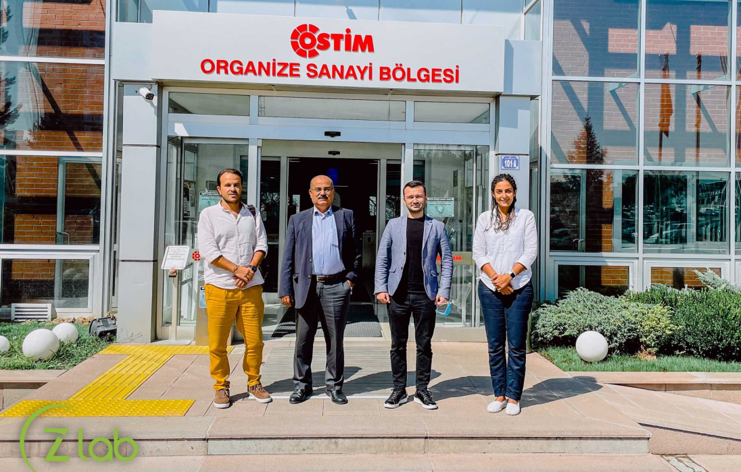
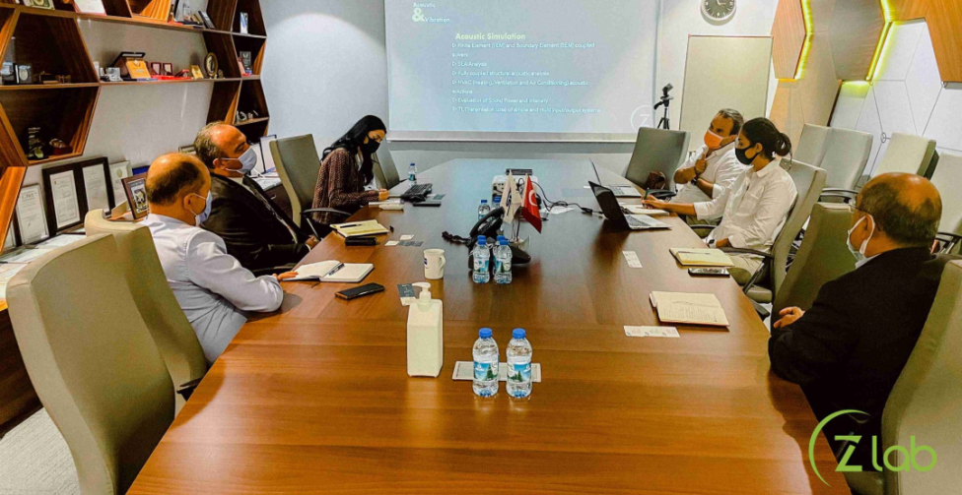
AGENDA :
5 full days
with organised 2 visits during each day
visits included Railway companies, Test Center, Technical University, Technology Center and Aviation-Defence Cluster
FEEDBACK :
“ Positive, VO and HO very satisfied.
Zetalab had a chance to know Railway Industry and OSTİM Ecosystem in Ankara Region.
Zetalab had agreement with some ARUS’ member companies. ”

Slide 11
From 4th to 6th of Mai 2022
i-Trans (HO)
&
PKTK (VO)
exchange
i-Trans, Innovation cluster for mobility, transports and logistics
from Valenciennes, France
https://i-trans.org/
&
Polish Cluster of Composite Technologies
From Malopolskie, Poland
http://pktk.pl/en/home/

Slide 12
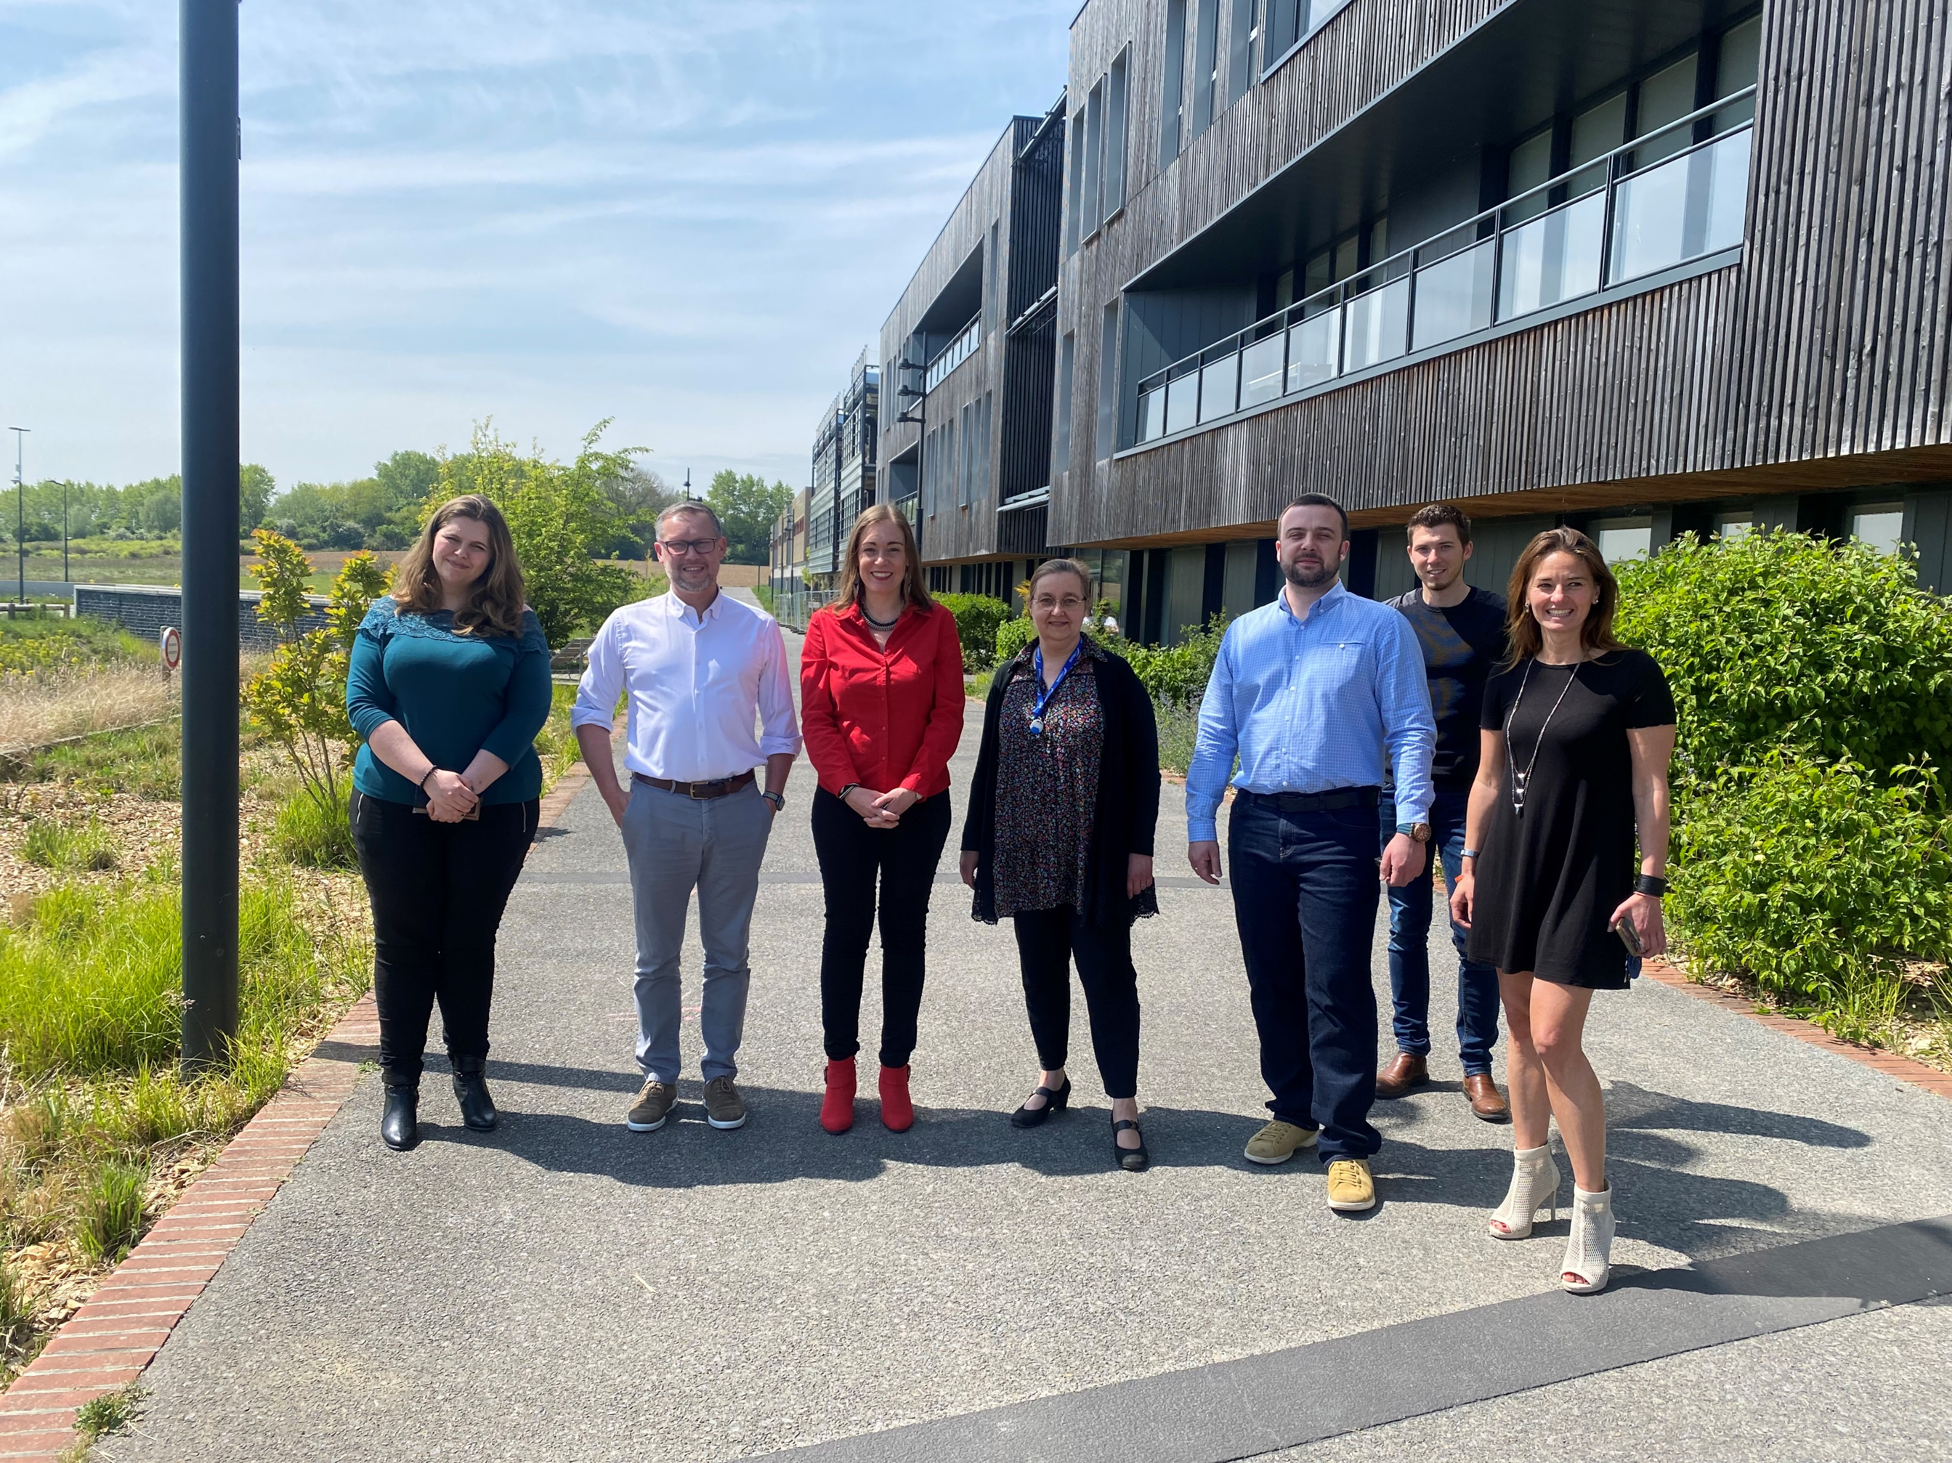
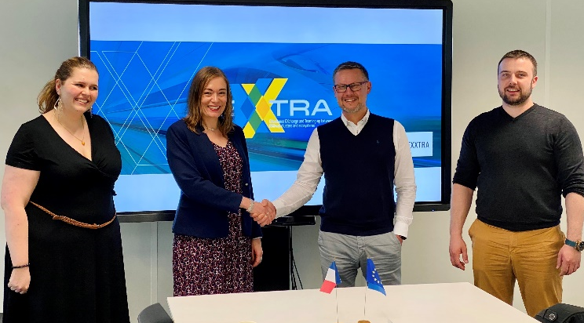
AGENDA :
Presentation of each cluster and services offered to members
Identification of possible synergies between members of the 2 clusters
Networking between French and Polish companies
Potential European collaboration both between clusters and companies
Best practices of each cluster
FEEDBACK :
“ Each participant was delighted to share experience and possibilities of cooperation.
The identified steps for future collaboration are to sign a LOI and a cooperation agreement in order to reinforce potential strategic international operations.”

Slide 13
From 10th to 12th of May 2022
ARUS (HO)
&
DITECFER (VO)
Teldat (VO)
exchange
Anatolian Rail Transportation Systems Cluster
from Ankara, Turkey
https://www.anadoluraylisistemler.org/
&
District for Railway Technologies, High Speed, Networks’ Safety & Security
from Pistoia, Italy
https://www.ditecfer.eu/
Telecomunication Systems for Railway Sector
from Madrid, Spain
https://www.teldat.com/

Slide 14
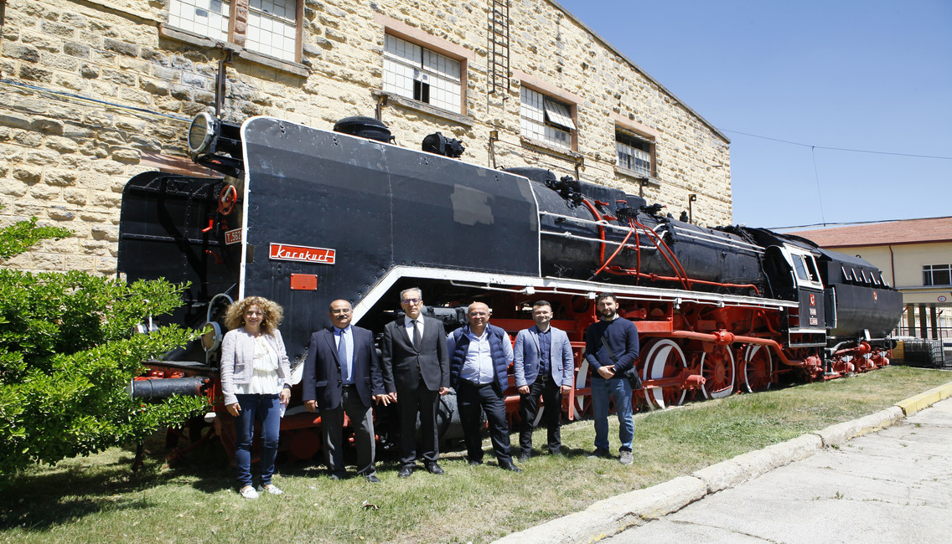
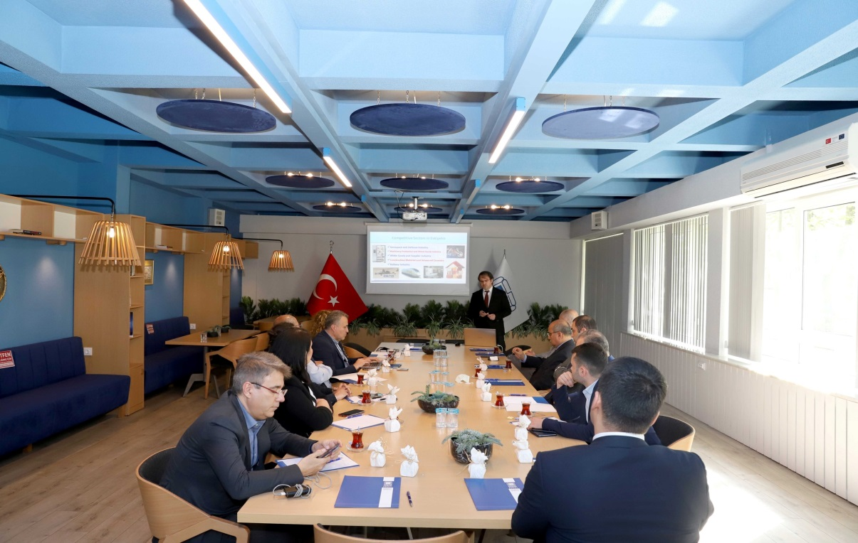
AGENDA :
Rail Industry Show ‘22
Company visits
Eskişehir Chamber of Industry visit
Presentation of Turkish Rail Supply Industry
FEEDBACK :
“ During the visits ARUS members had opportunity to know Italian and Spanish business culture,railway industry.
Eskişehir is the heart of railway industry in Türkiye. For this reason VOs saw where Turkish railway sector is and its past also future ”

Slide 15
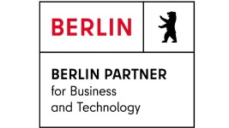
From 20 to 22 of June 2022
DITECFER (HO)
&
15 VOs
Group Exchange
DITECFER - District for Railway Technologies, High Speed, Networks’ Safety & Security
from Pistoia, Italy
https://www.ditecfer.eu/
&
7 clusters (ARUS, Berlin Partner, Mafex, Censec, In Move by Railgrup, Järnvagsklustret, Southern Railway Cluster), technology center, technopark and 6 SMEs
from Turkey, Germany, Spain, Denmark, Sweden, Poland, Belgium

Slide 16
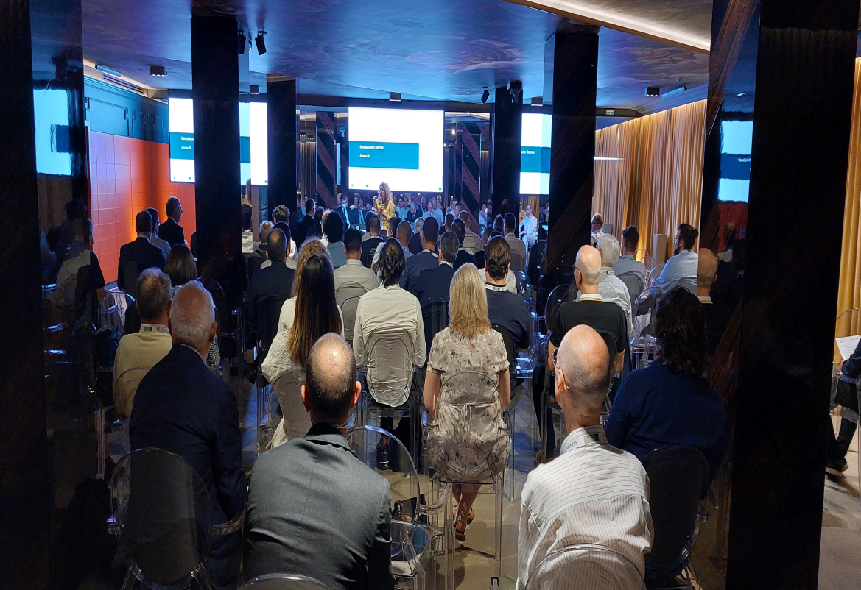
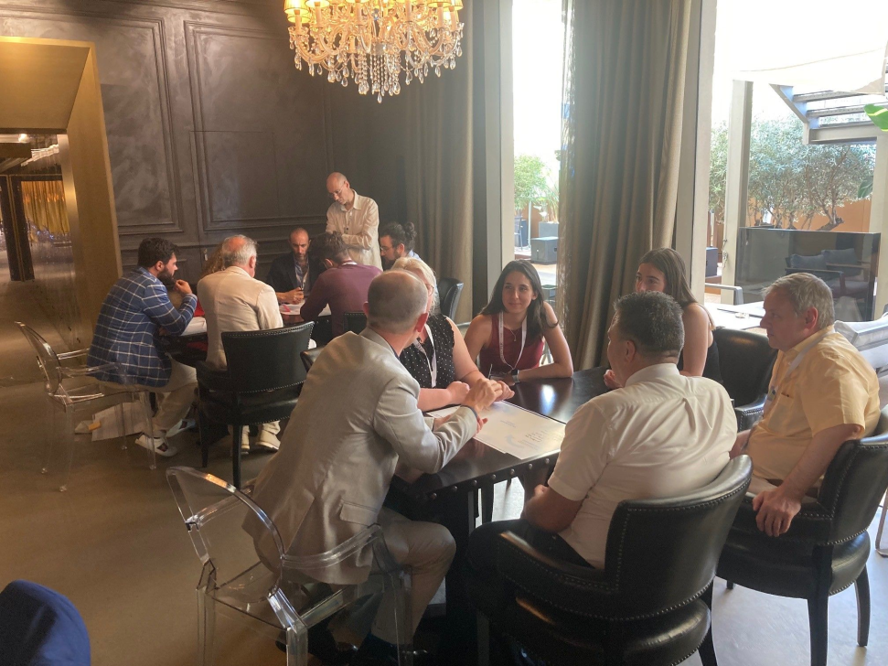
AGENDA :
The first two days were dedicated to presentations and discussions on topics related to Blockchain (with AI, digital twins) in Railway sector and Cybersecurity in Multimodality.
During the second day afternoon a bigger focus was given to use cases and practical part of the exchange with working in groups of participants.
The third day of exchange offered the possibility to visit the Marble Quarries and Cava Museum, Carrara Sculptures Cooperative and Port of Marina di Carrara.
FEEDBACK :
“ We have discussed about cybersecurity and blockchain in railways and multimodal transportation, with interesting use cases and applications as well as state-of-the-art on technologies and regulations. It has been also a good occasion to exchange opinions and visions with many other railways stakeholders from Italy and abroad.”
Francesco F. Fruci (SEGULA Technologies)

Slide 17
From 6 to 8 of September 2022
CenSec (HO)
&
6 VOs
Group Exchange
CenSec – Center for Defece, Space and Security
from Copenhagen, Denmark
https://censec.dk/
&
Berlin Partner, Bulgarian Digital Cluster, DITECFER, Elfi Electronics, i-Trans, Neurospace
from Bulgaria, France, Germany and Italy

Slide 18
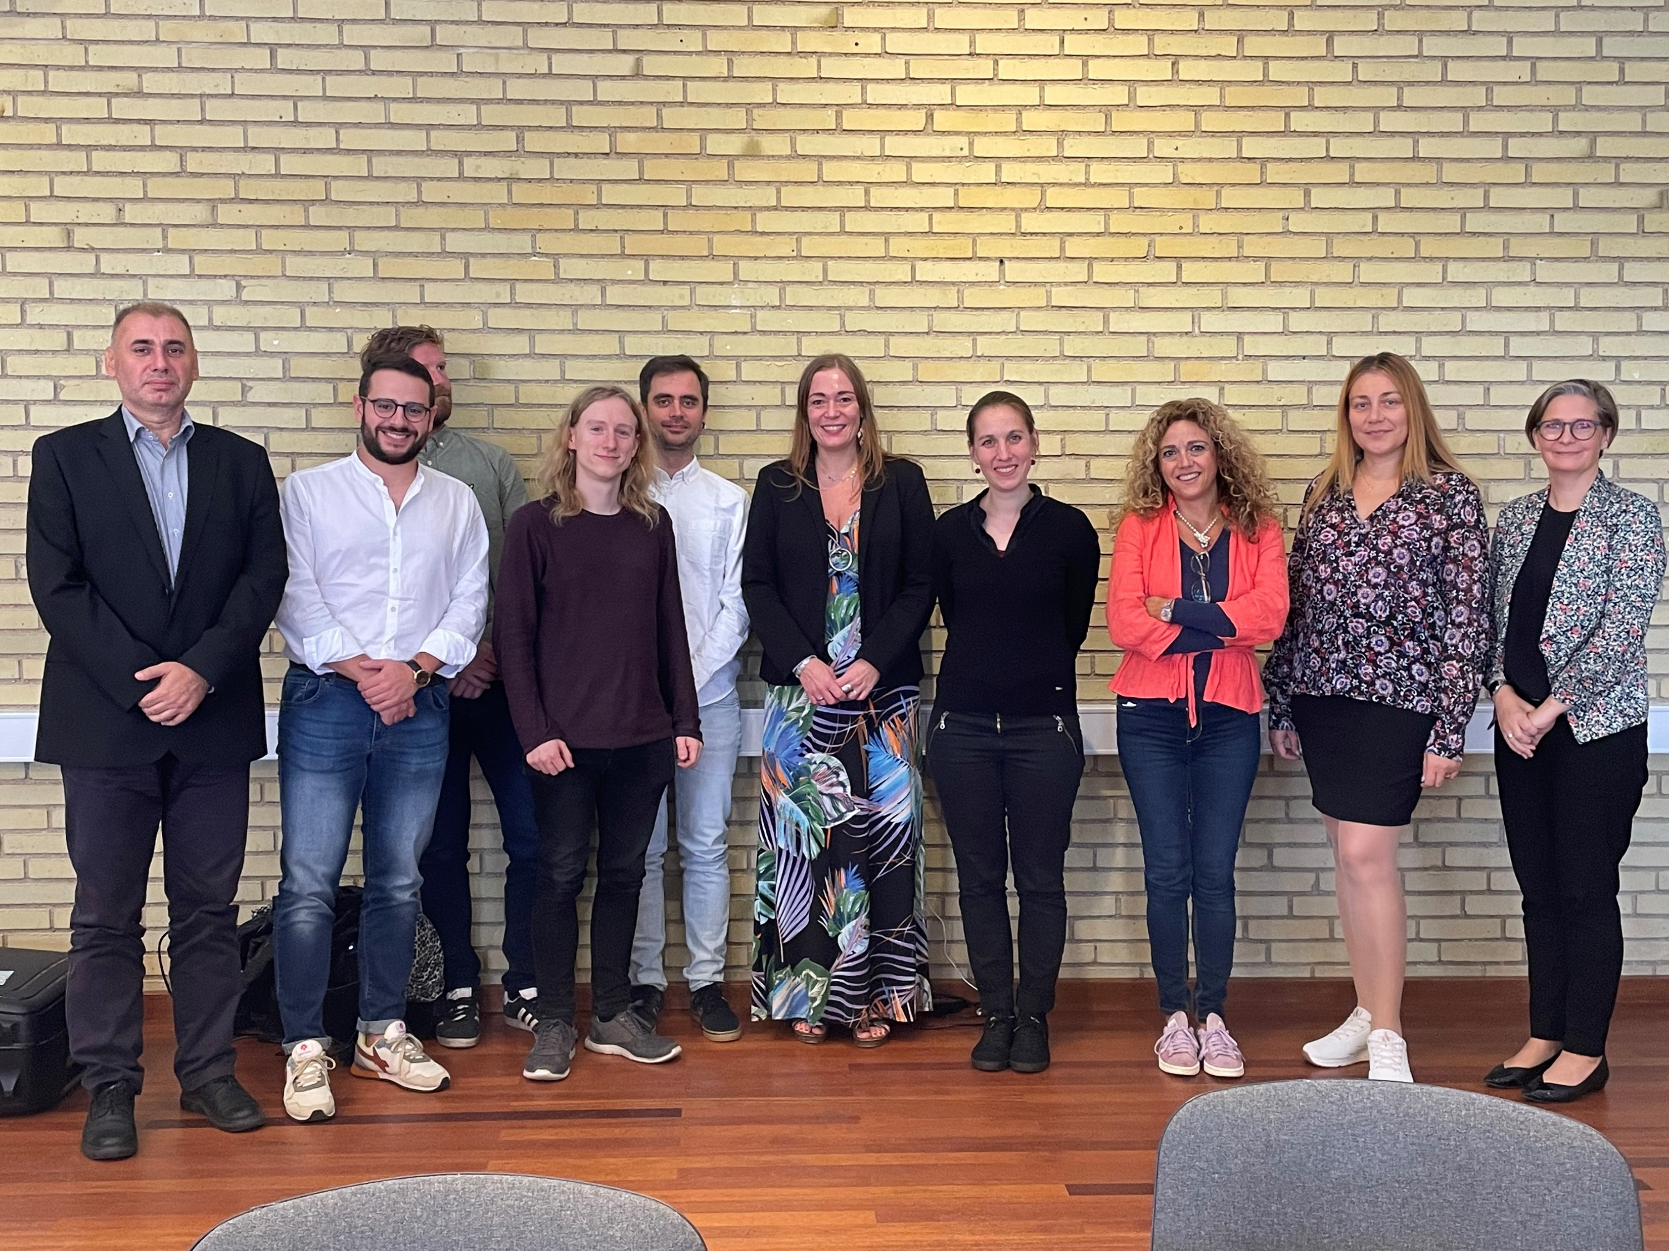
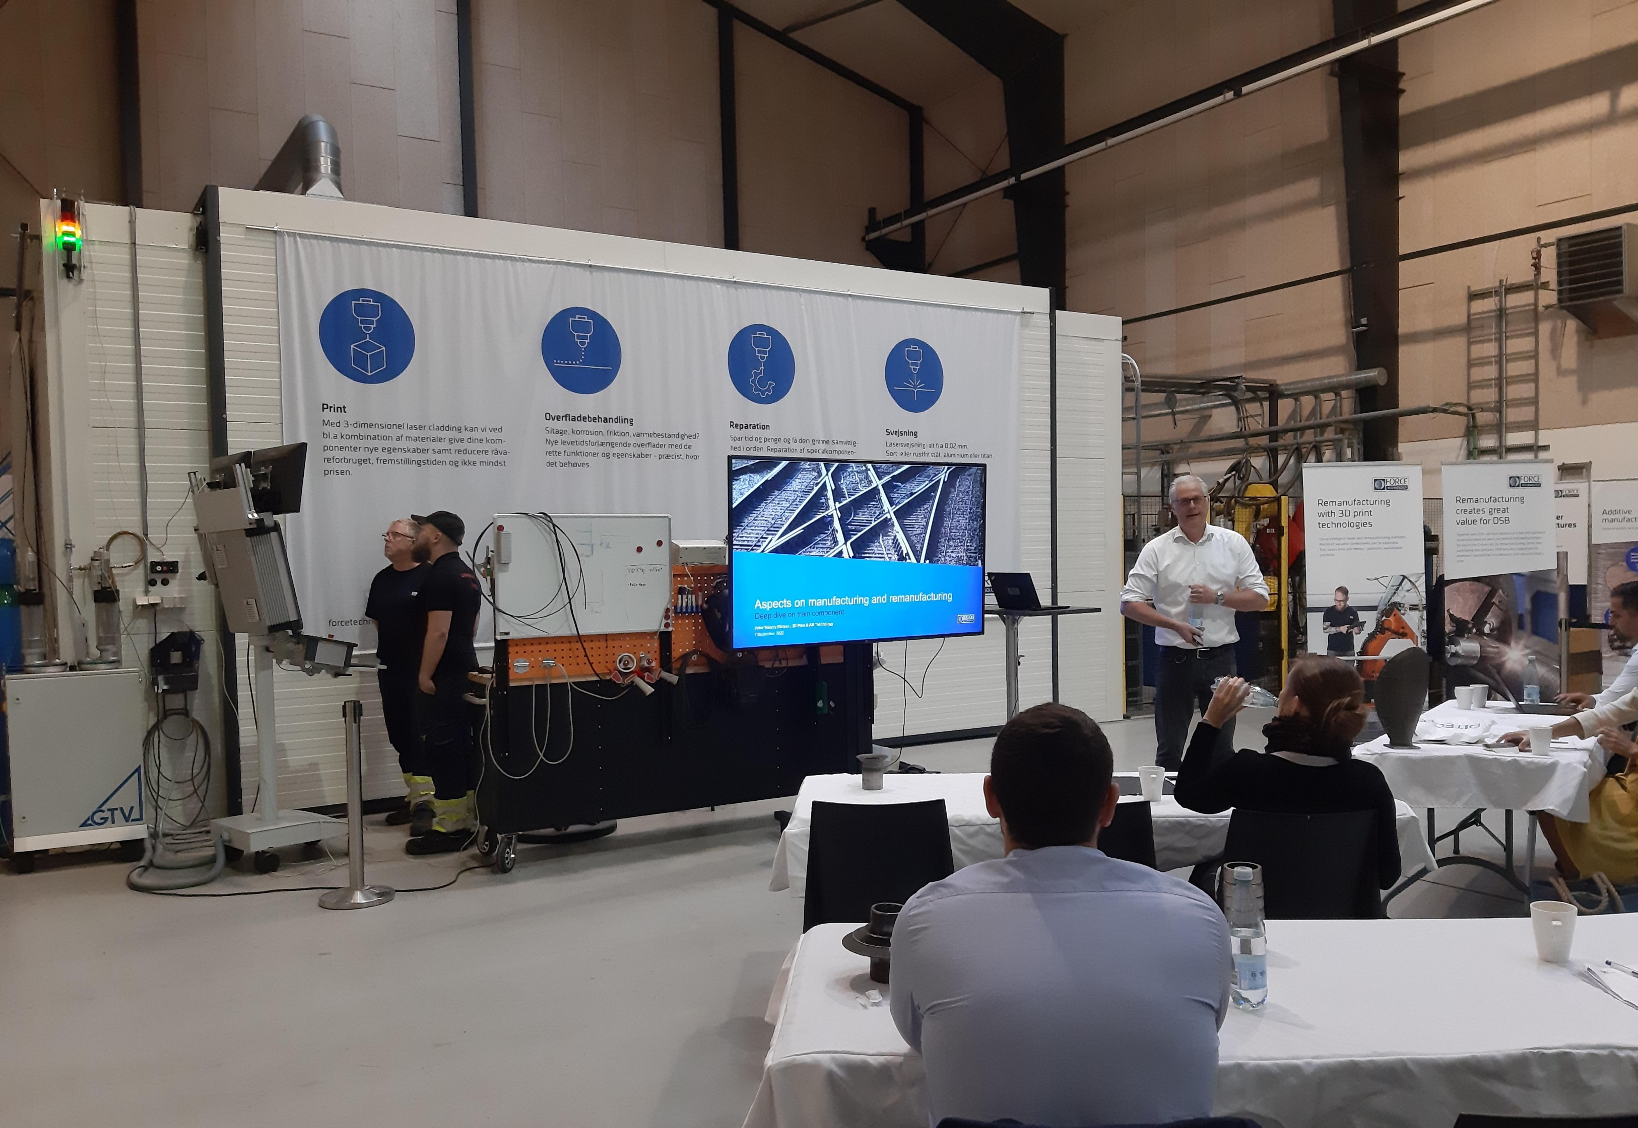
AGENDA :
Introduction to the Danish railway, space and security sectors, key stakeholders and ecosystems
Get better insights into how to use European satellite technologies and data for railway applications
Identify synergies between railway, space and security sectors and stakeholders
Site and company visits at key stakeholders both regarding research and technology organisations (RTOs) and companies.
FEEDBACK :
“ It was a unique opportunity to learn how the European satellite technologies and data can be used for railway applications, and to explore synergies among railway, space and security stakeholders.”

Slide 19
https://exxtraproject.eu/
@Exxtra_EU
https://www.linkedin.com/groups/13844027/
 | This video was funded by the European Union’s COSME Programme. The content of this video represents the views of the author only and is his/her sole responsibility; it cannot be considered to reflect the views of the European Commission and/or the European Innovation Council and SME Executive Agency (EISMEA) or any other body of the European Union. The European Commission and the Agency do not accept any responsibility for use that may be made of the information it contains.

